Slide 1
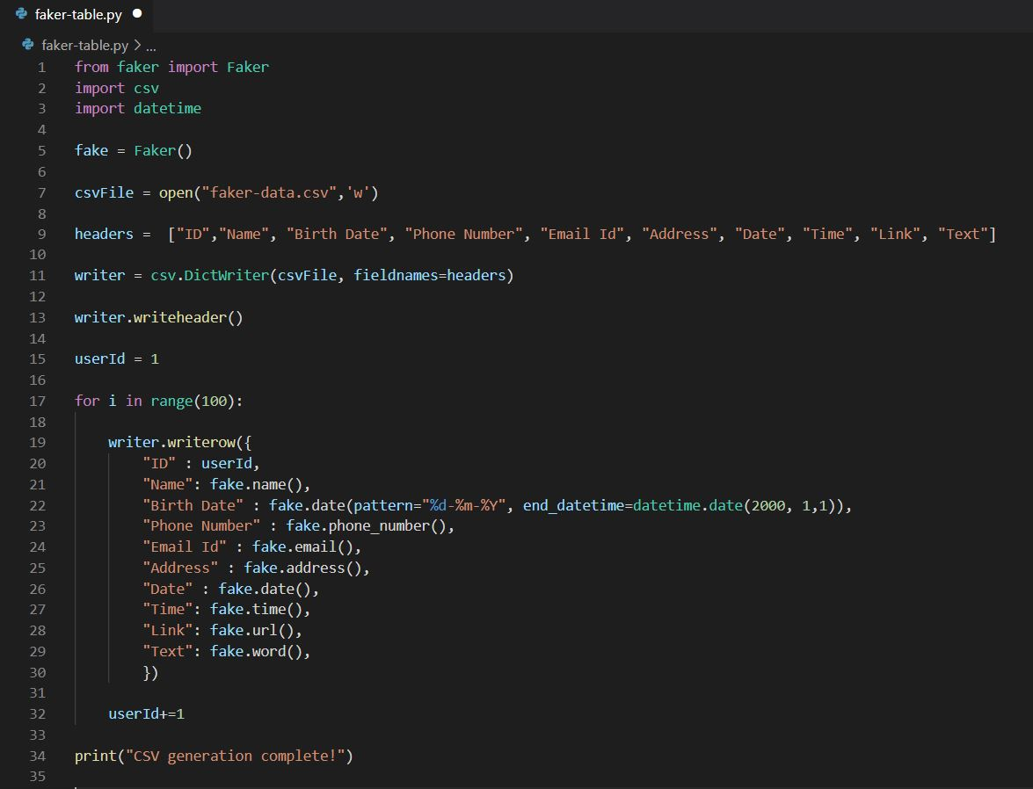
Create dummy CSV record using Faker

Slide 2



Output CSV File

